Slide 1
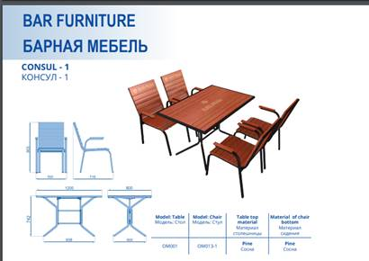
Not final design

Slide 2
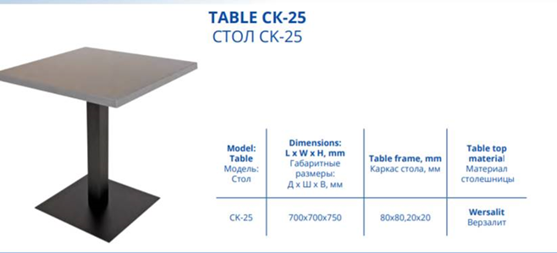
Not final design we will provide chairs as well

Slide 3
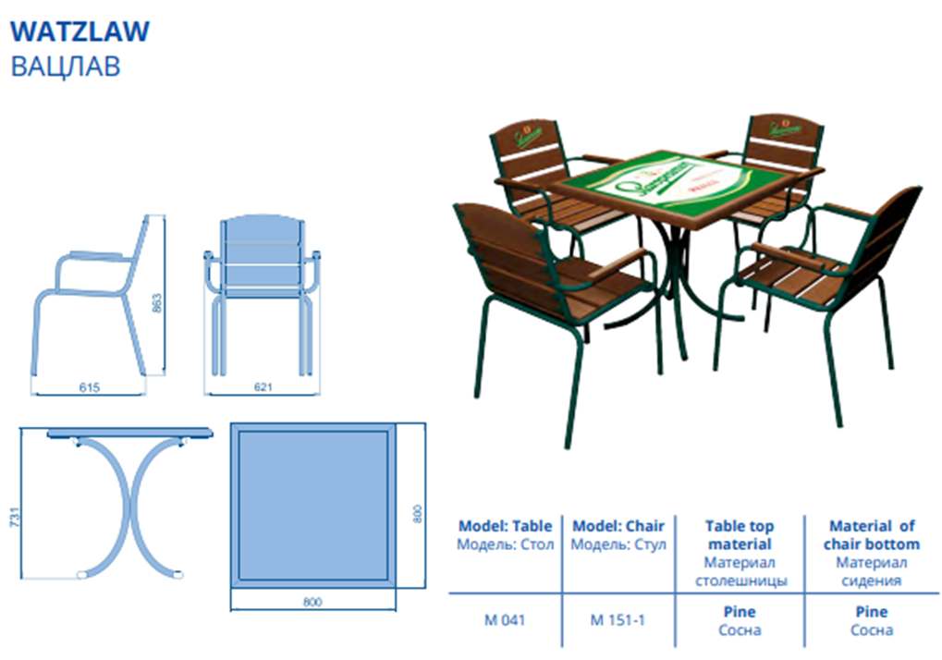
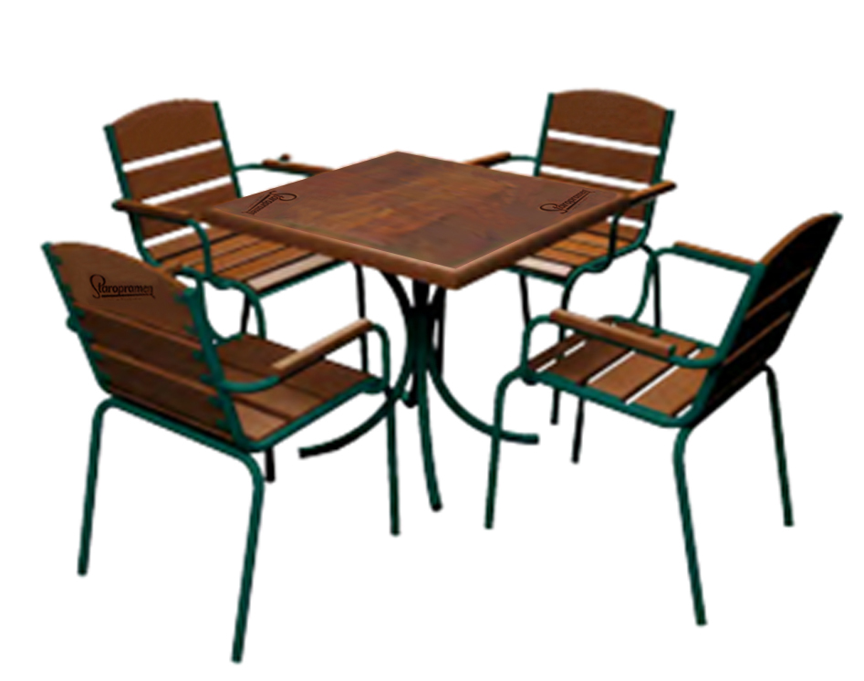
Staropramen’s Table set quality should be much better than the standard ones

Slide 4
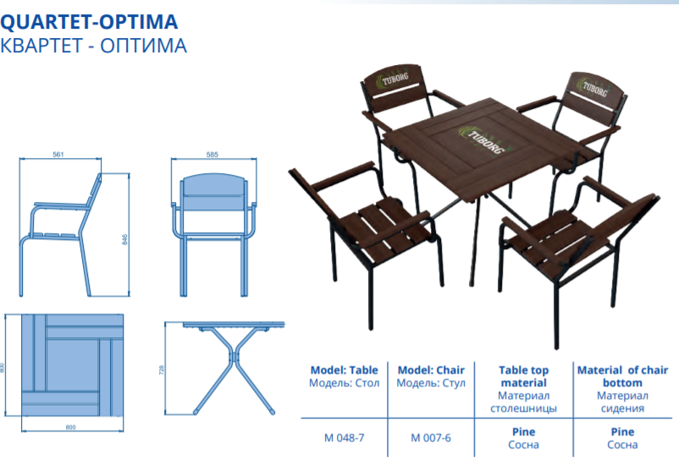

EFES branding on chairs and table

